Slide 1
JOURNEY SCRAPBOOK Technical Training - Week 6 25-Sep-2023 to 29-Sep-2023 (Days 18 – 22)
Yuva Sahith Varma Sangaraju
Batch - 3

Slide 2
Day 18 – PySpark Features
Caching vs Persistence
Default storage levels for rdd, df and ds
Storage types in persistence
Aggregation
Managed and external tables
Unmanaged and hive tables
Partitioning by column and saving partitions
ForEach loop
Azure Databricks and ML – Cluster and compute nodes
Overview of Spark

Slide 3
Day 18 continued…
Know your data, Data ingestion and Preparation
Cost estimation and parallelism
Csv data and its reader modes, options
Databricks community edition configuration
Retail dataset activity

Slide 4
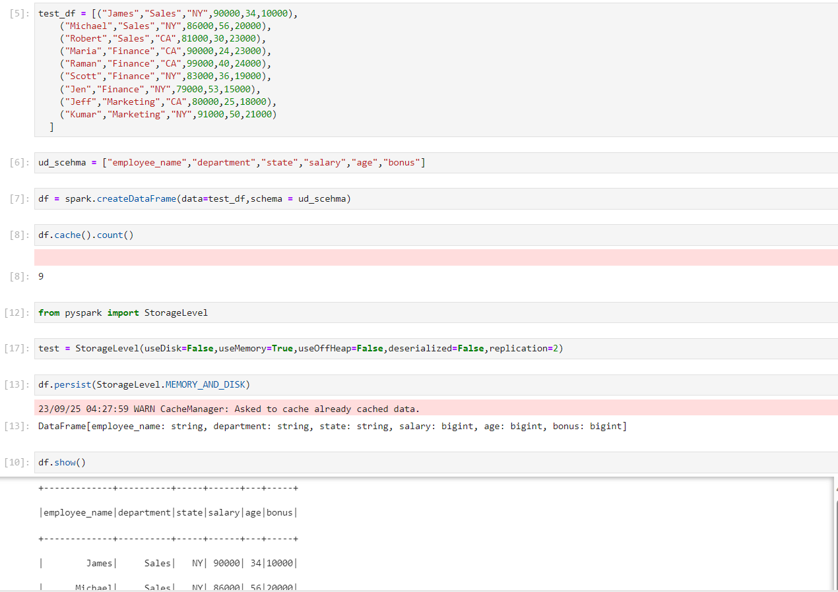

Slide 5
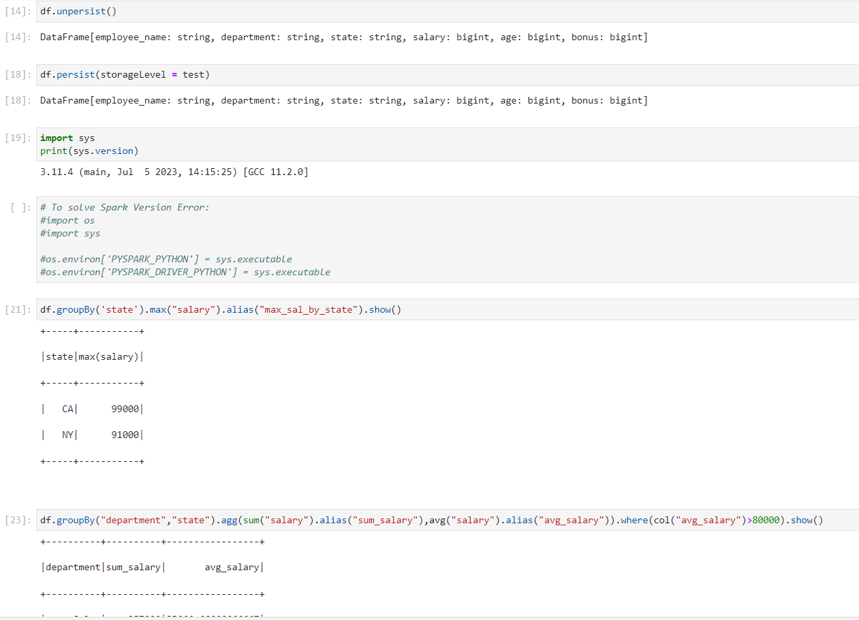

Slide 6
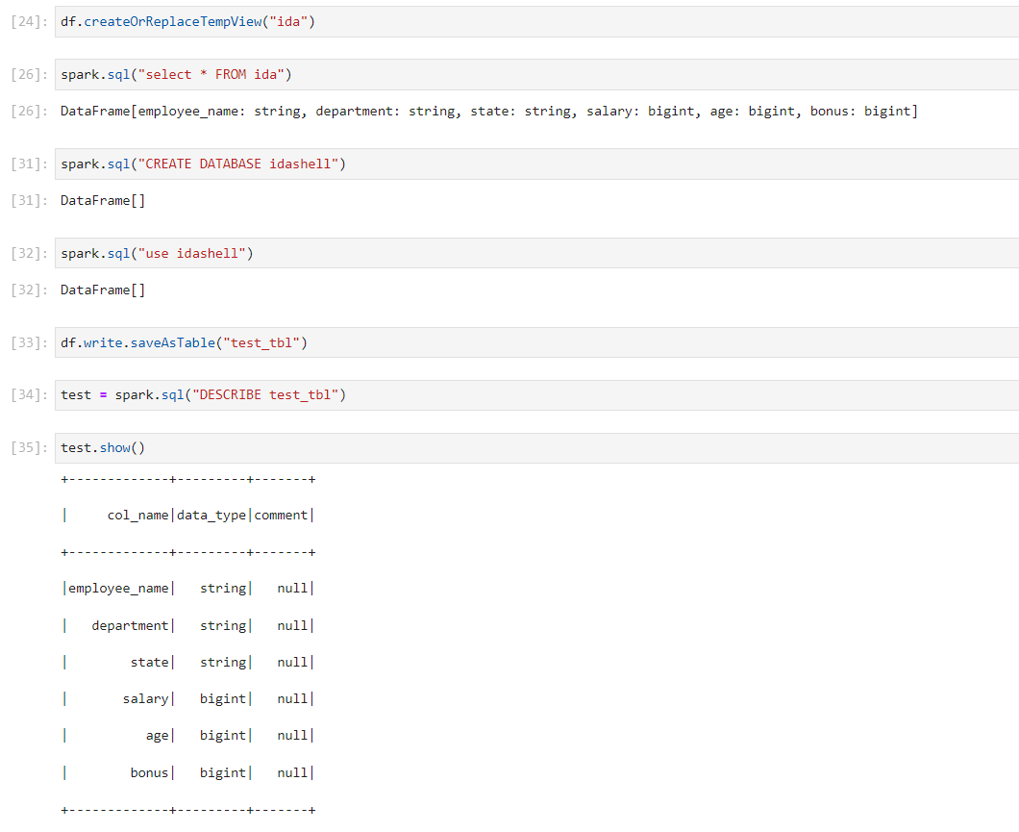

Slide 7
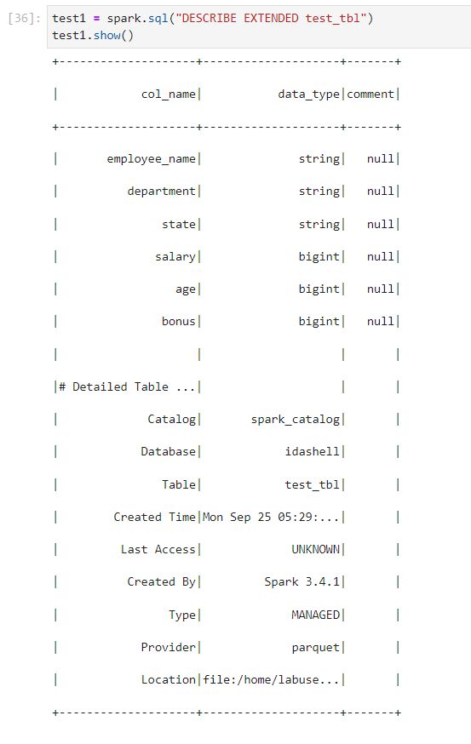
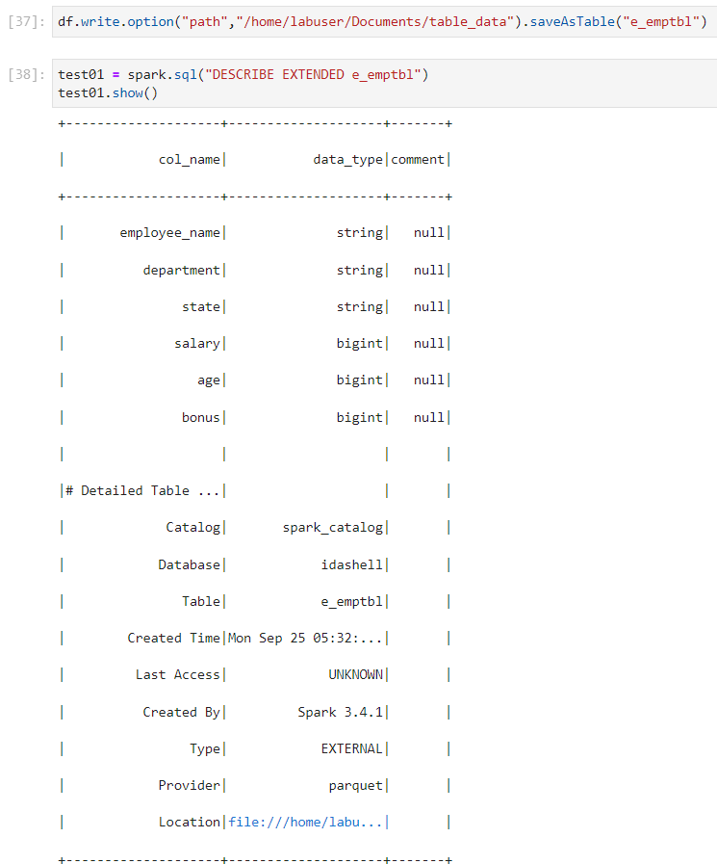

Slide 8
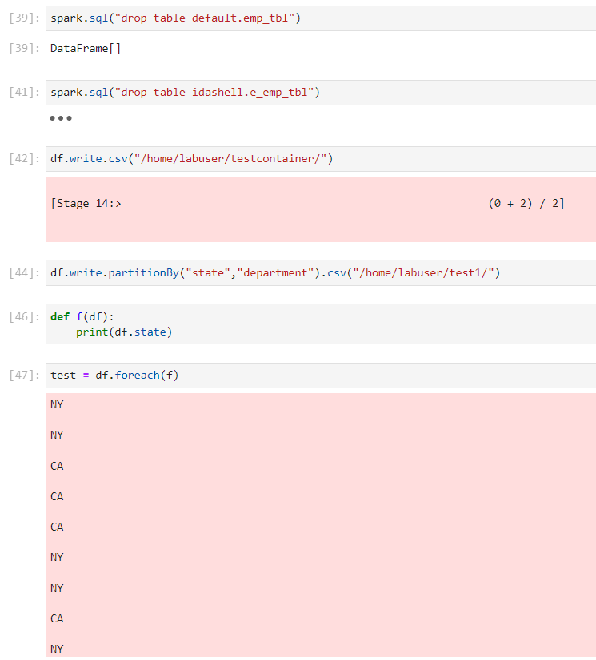
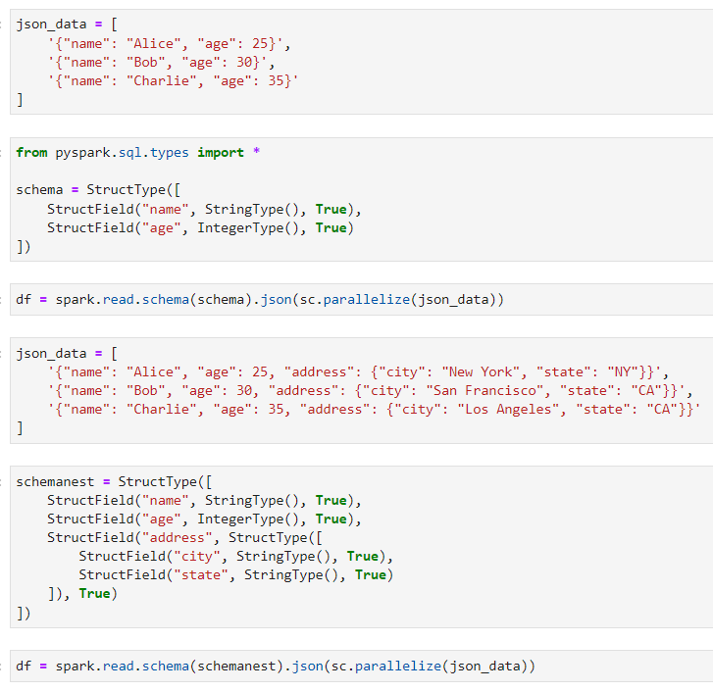

Slide 9
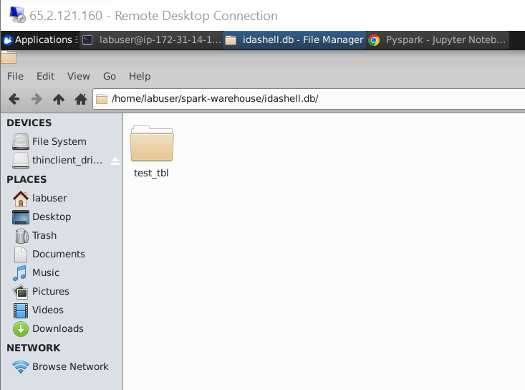
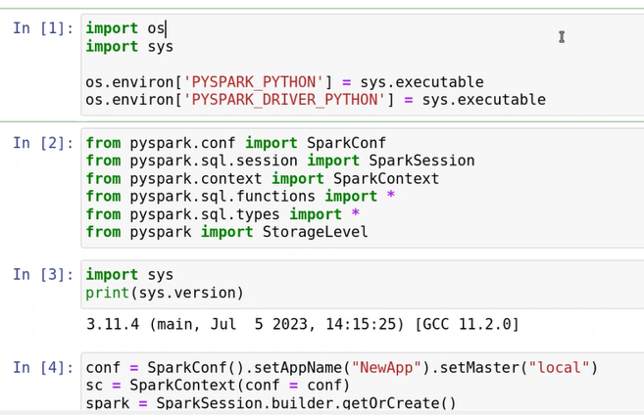

Slide 10
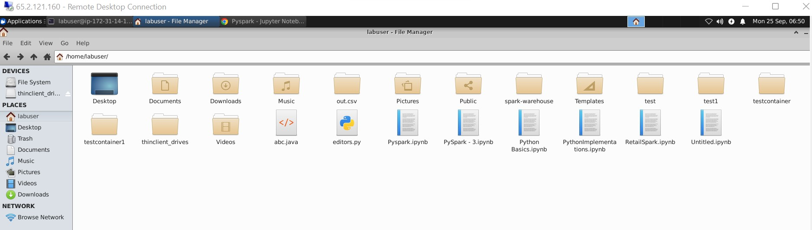
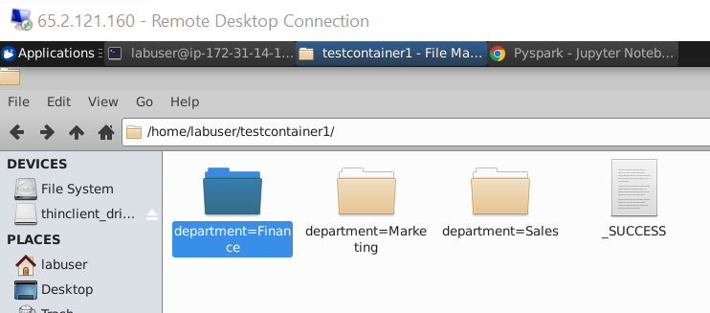

Slide 11
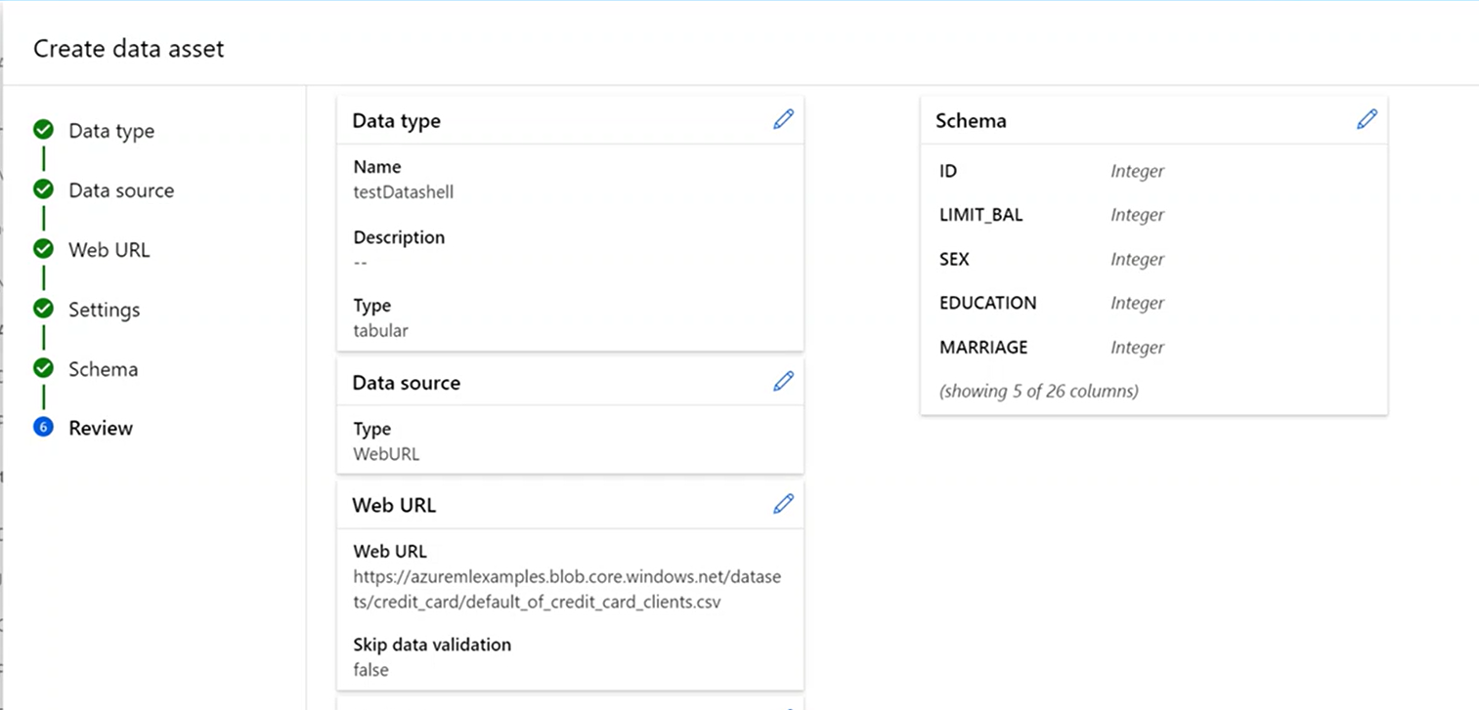

Slide 12
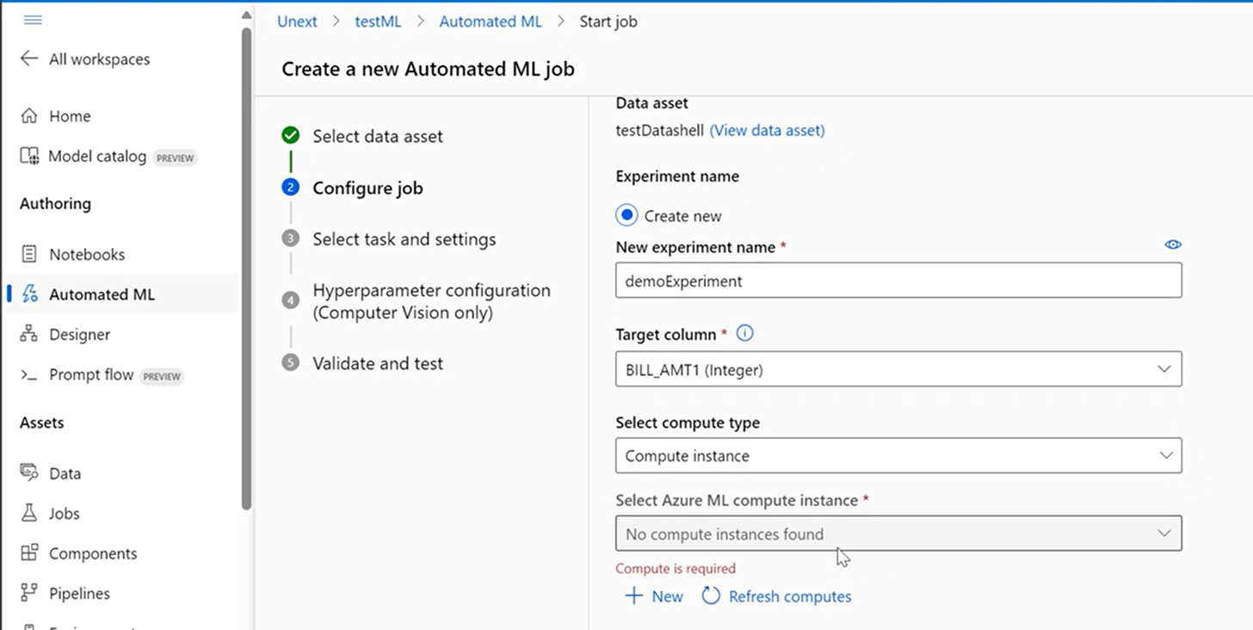

Slide 13
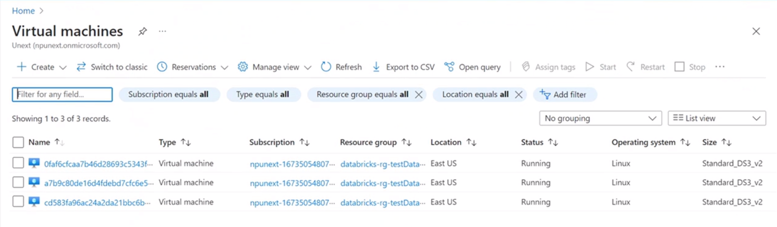

Slide 14
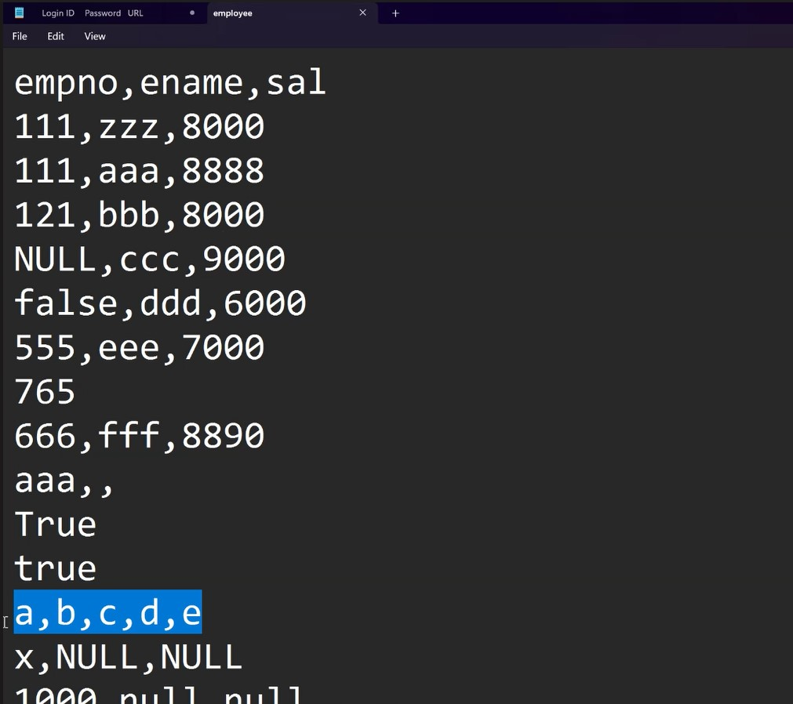

Slide 15
Day 19 – Azure Databricks
Introduction to Databricks and its features
Azure databricks workspace
Magic command to switch languages
Markdown and repos
Catalog and delta live tables
Compute types
Jobs and scheduling
Mounting storage to ADB
Creating ADLS Gen2 and Key vault service
Secret scope and the mount command

Slide 16
Day 19 continued…
Parametrization and widgets
Widget functions such as get, remove and text
DBFS and dbutils functions
Reconfiguring cluster and Utility notebook
Registering functions
Exporting folder as DBC to keep the backup
Structured streaming and Streaming process
writeStream modes
Checkpoint and droplocation

Slide 17
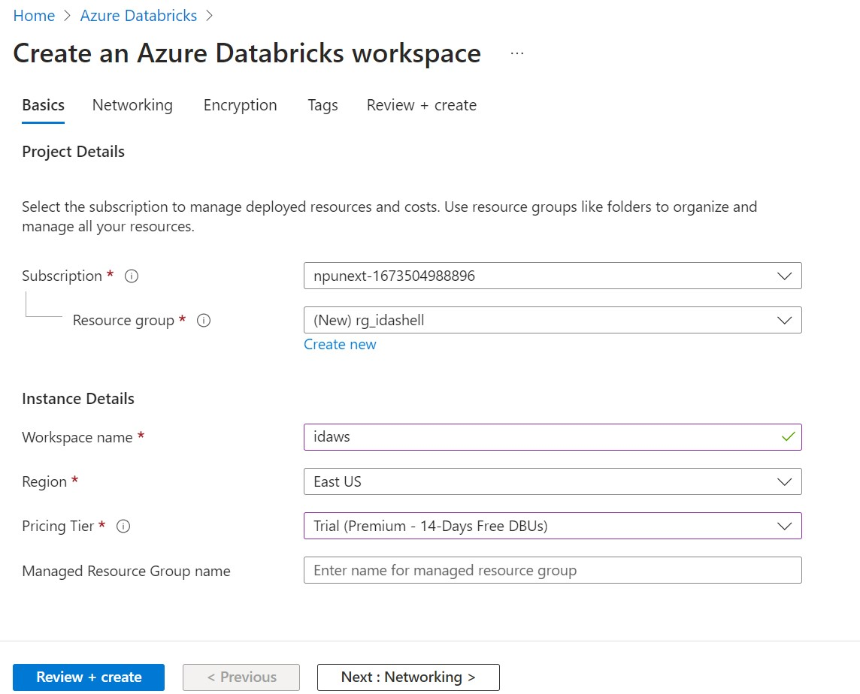

Slide 18
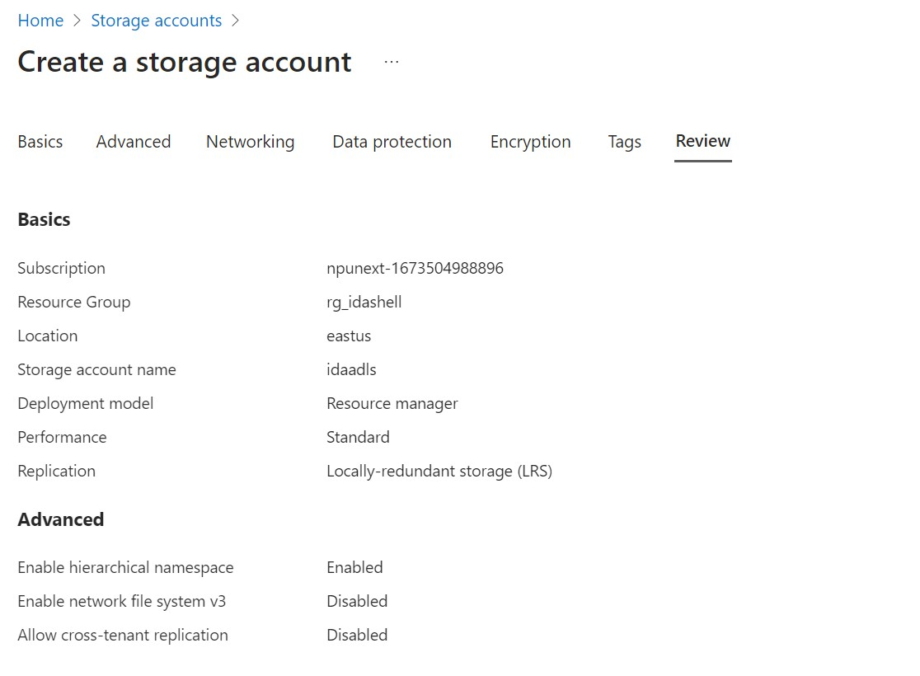

Slide 19
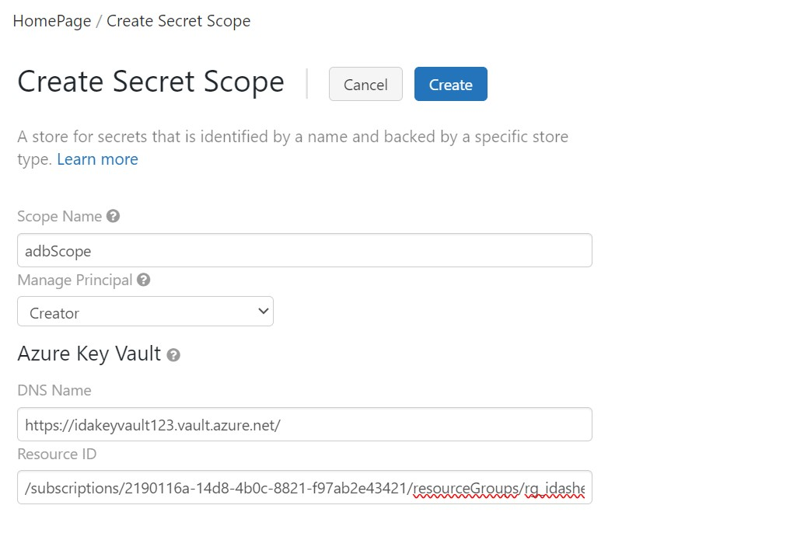

Slide 20
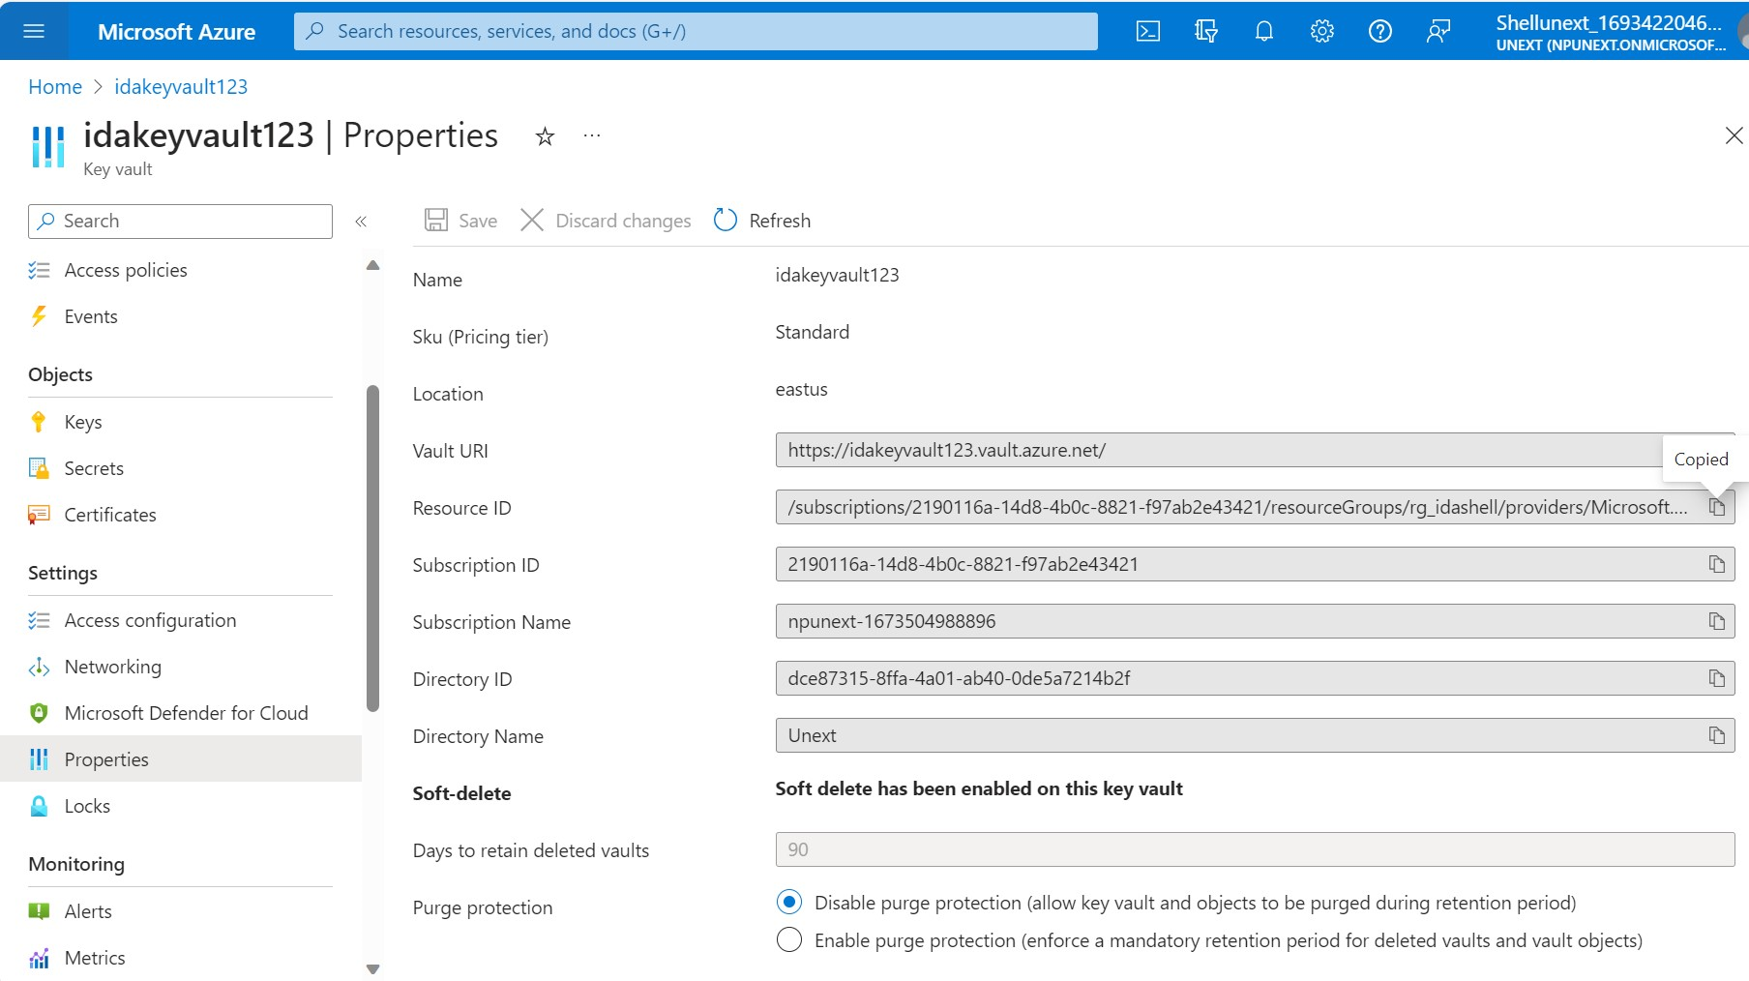

Slide 21
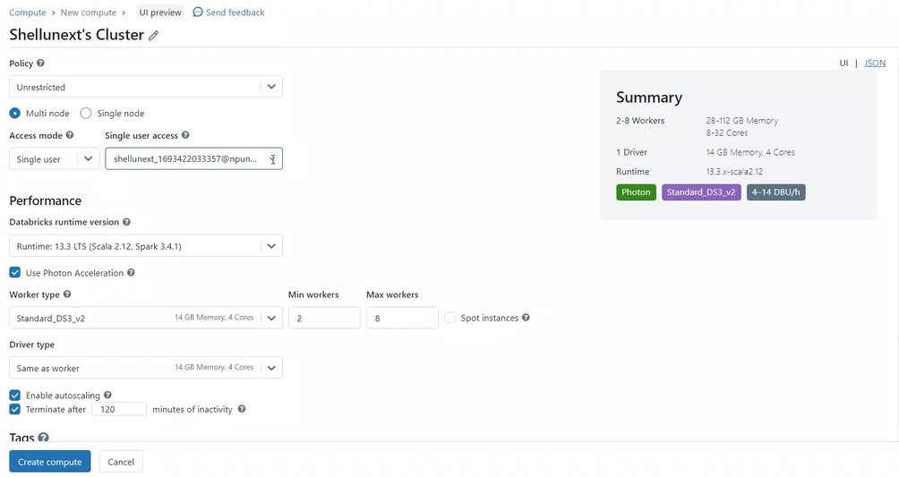

Slide 22
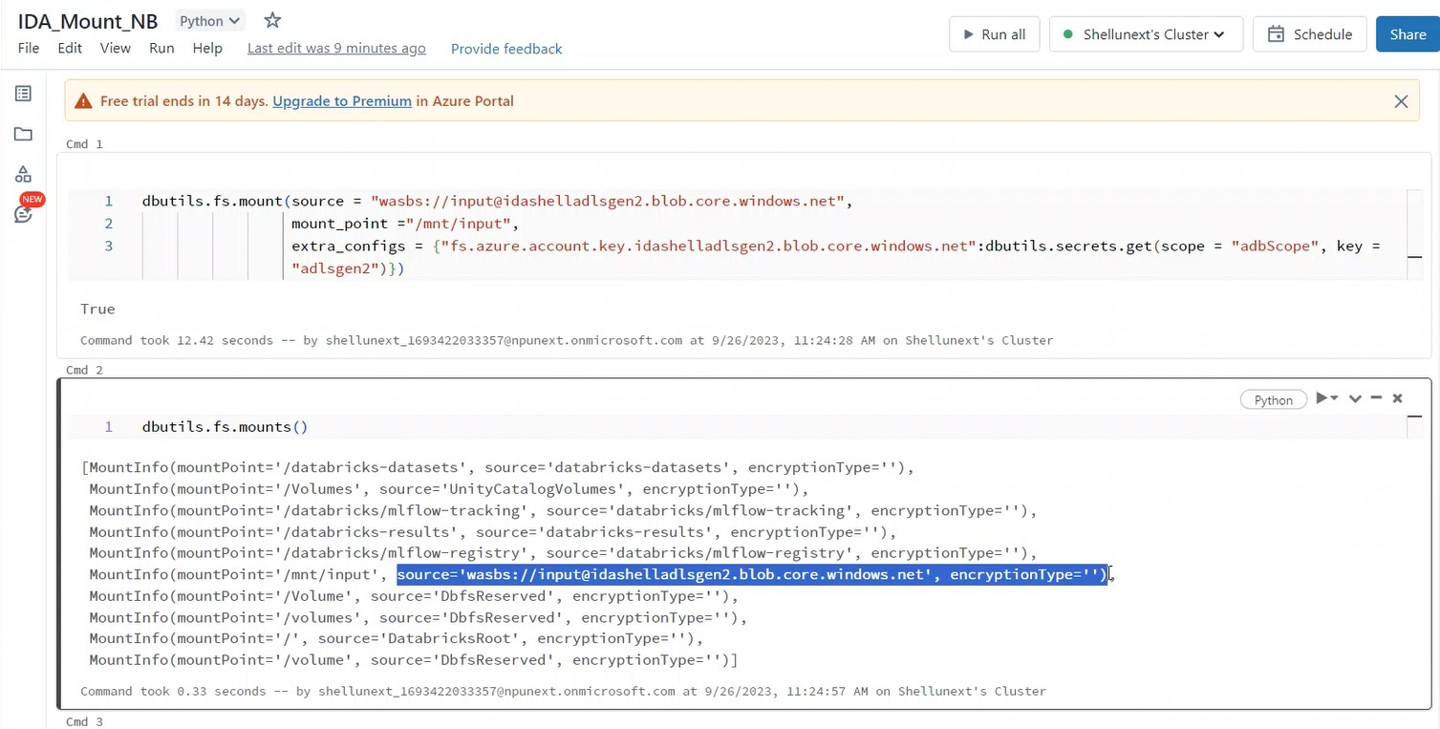

Slide 23
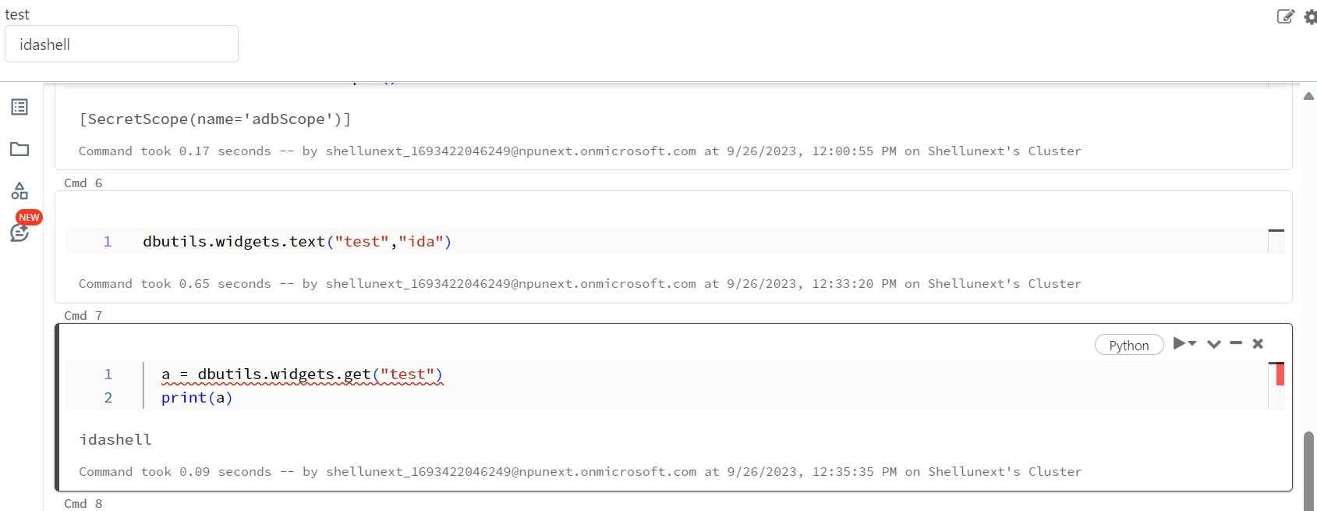

Slide 24
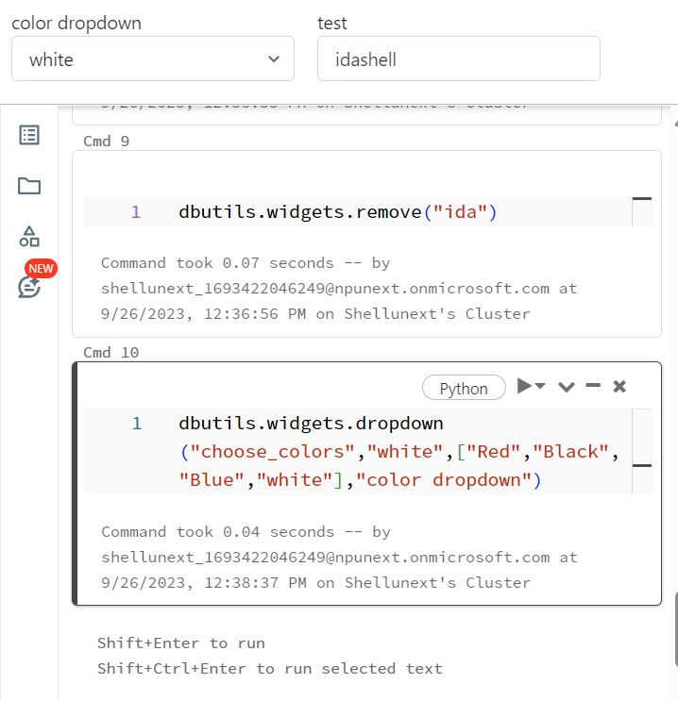

Slide 25
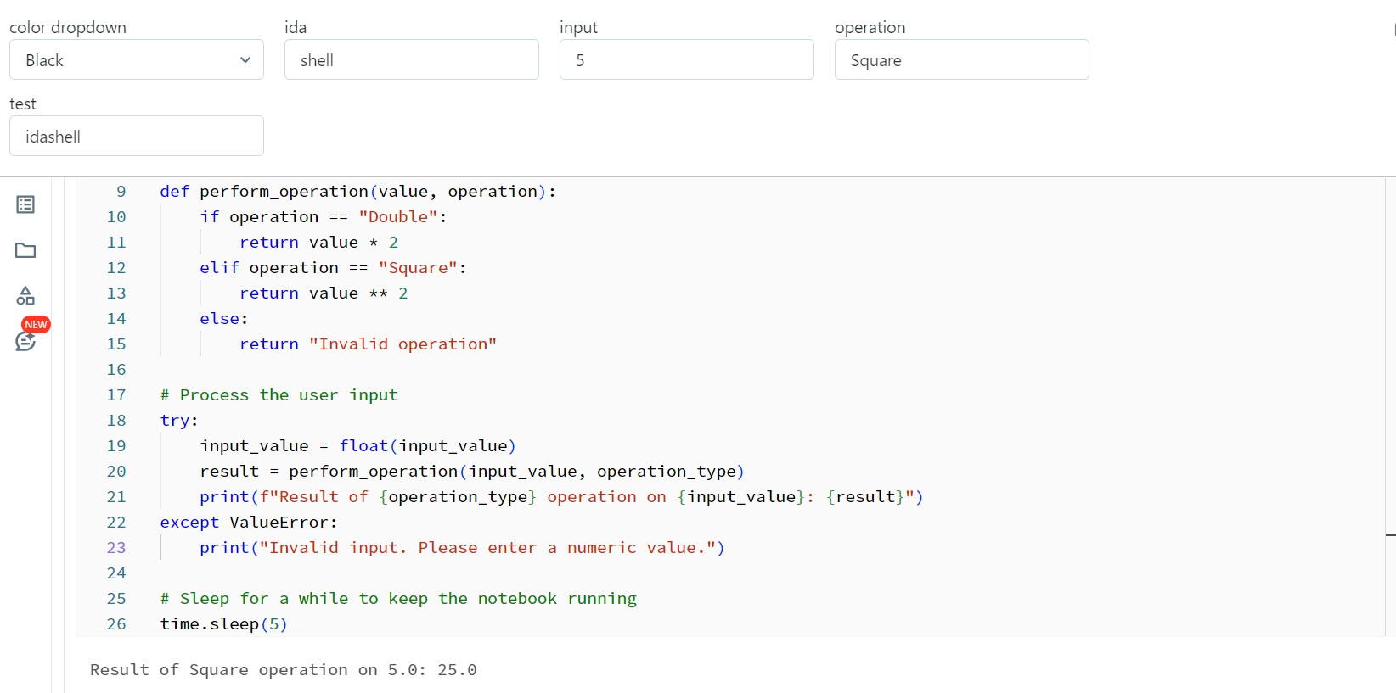

Slide 26
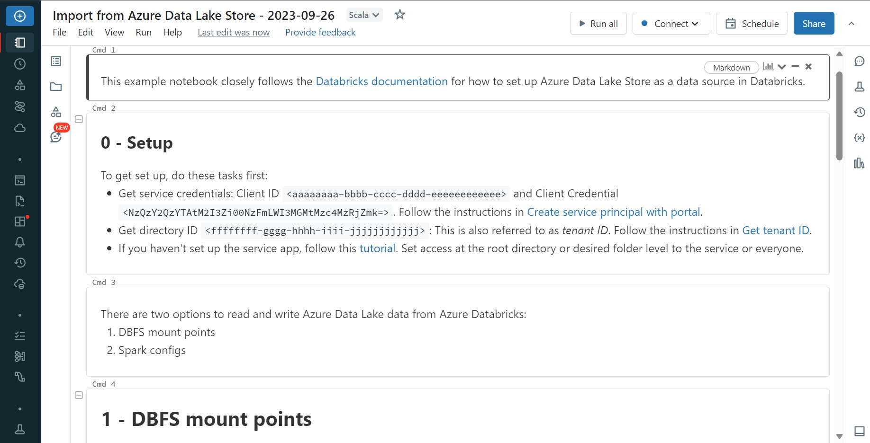

Slide 27
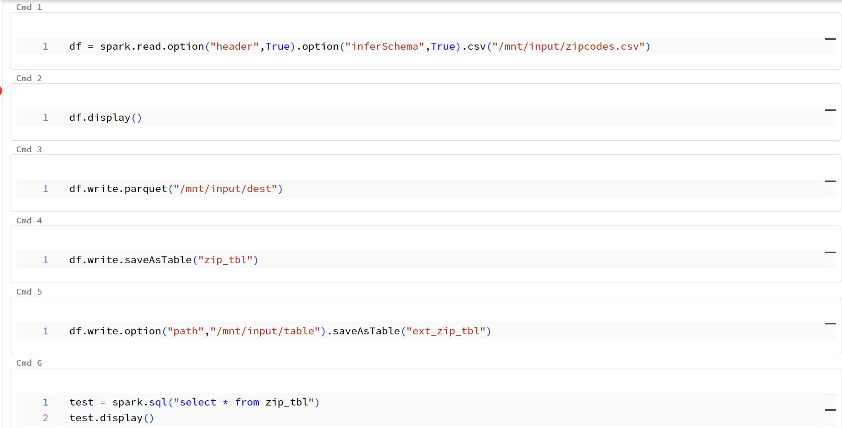

Slide 28
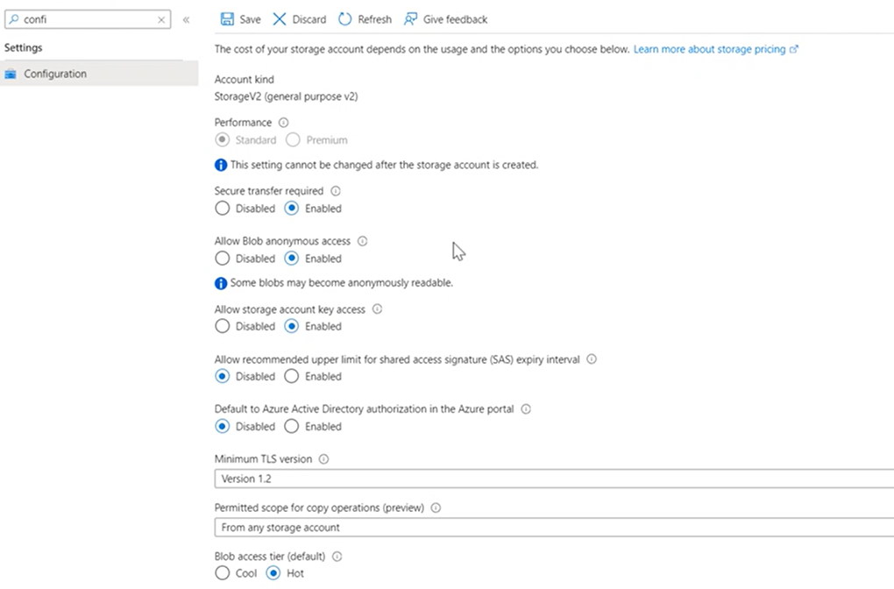

Slide 29
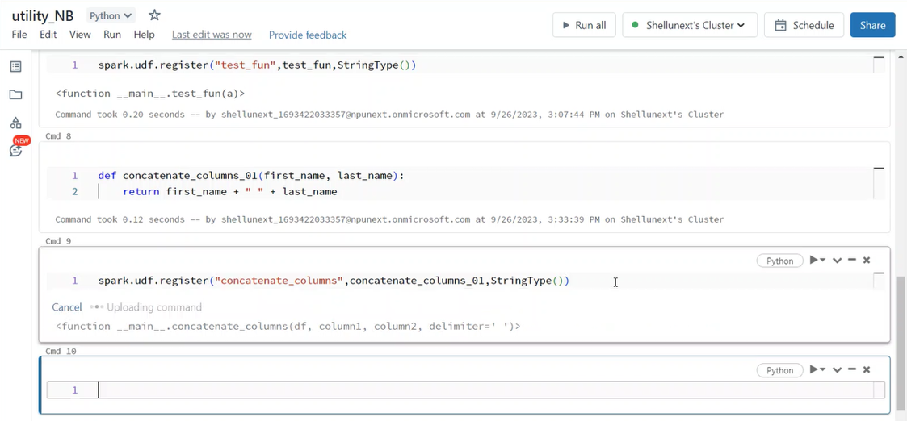

Slide 30
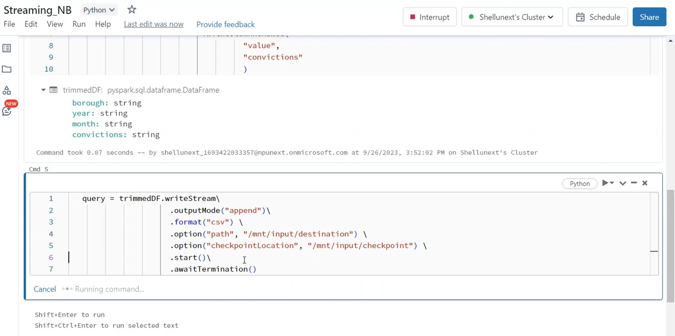

Slide 31
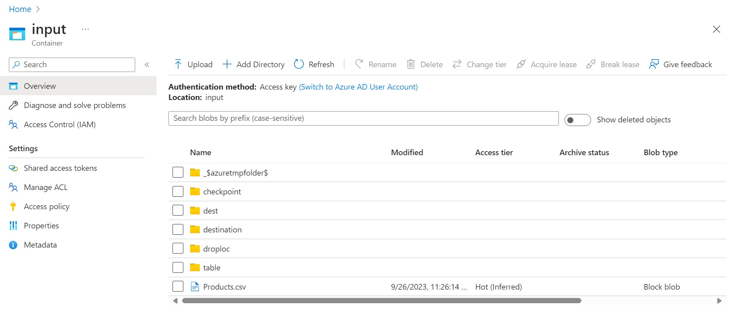

Slide 32
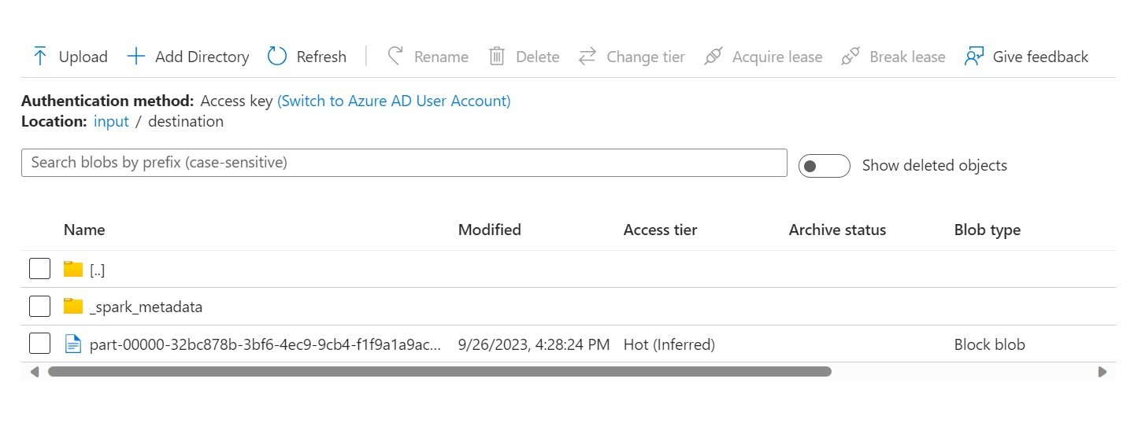

Slide 33
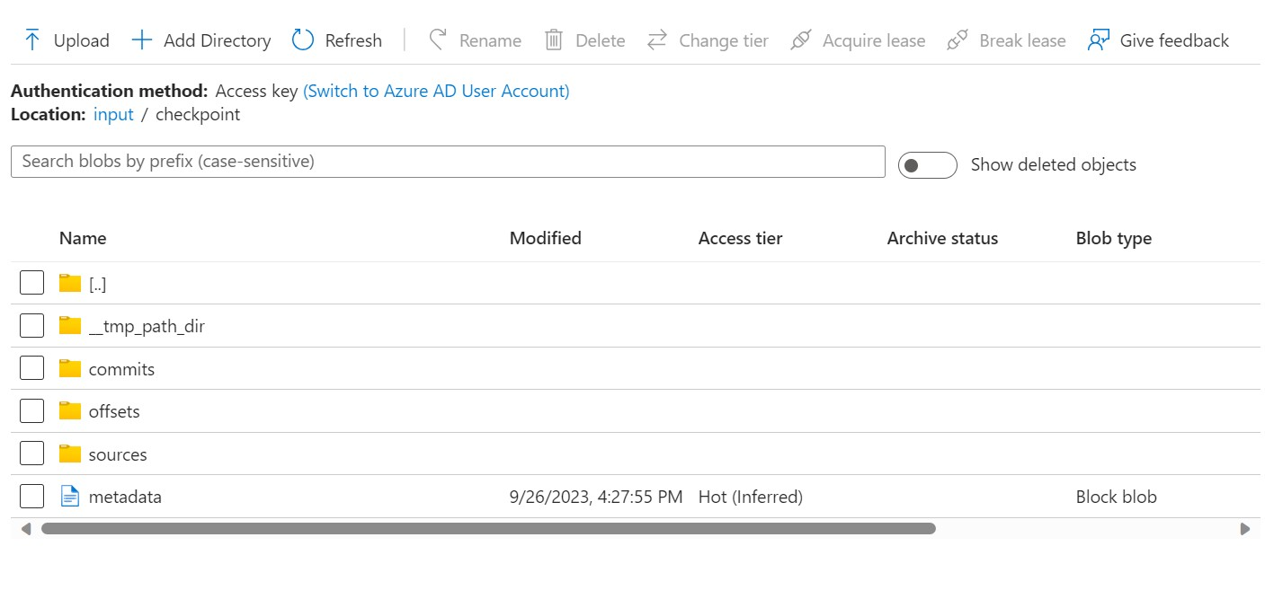

Slide 34
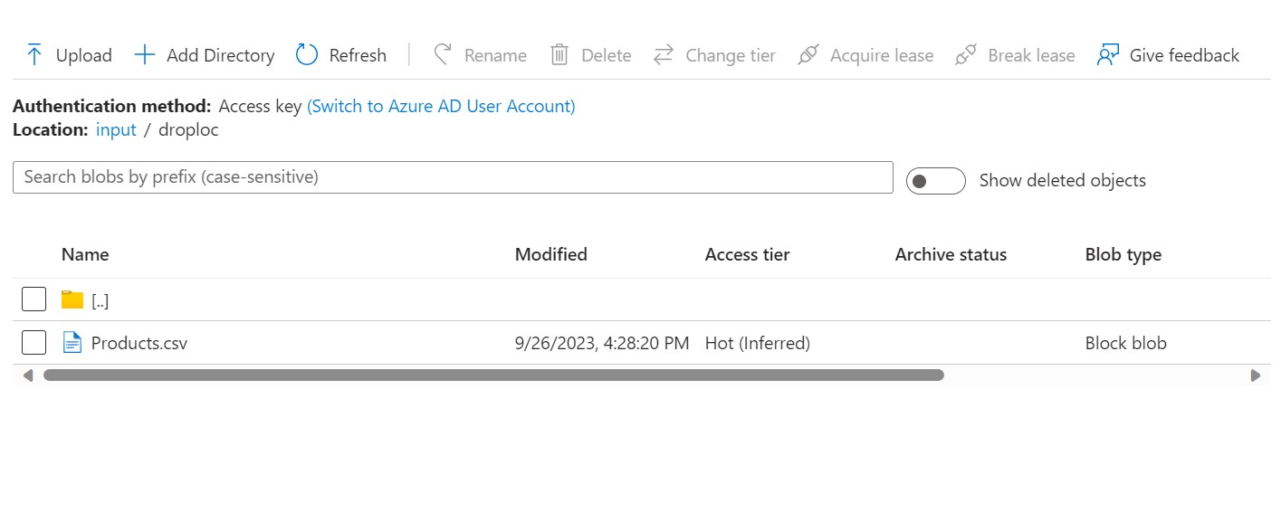

Slide 35
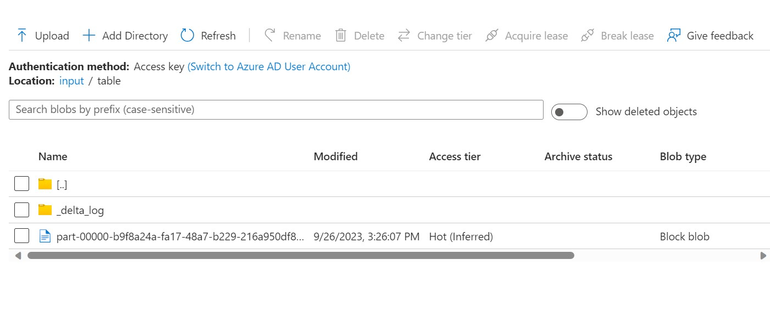

Slide 36
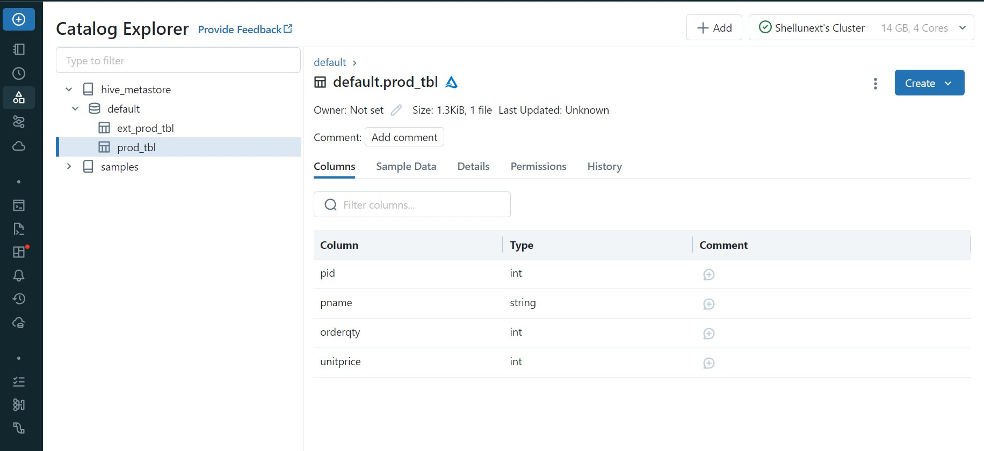

Slide 37
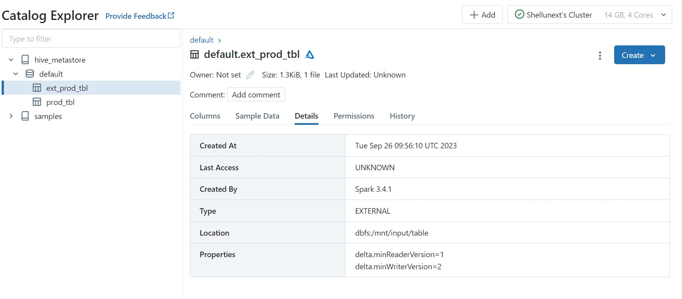

Slide 38
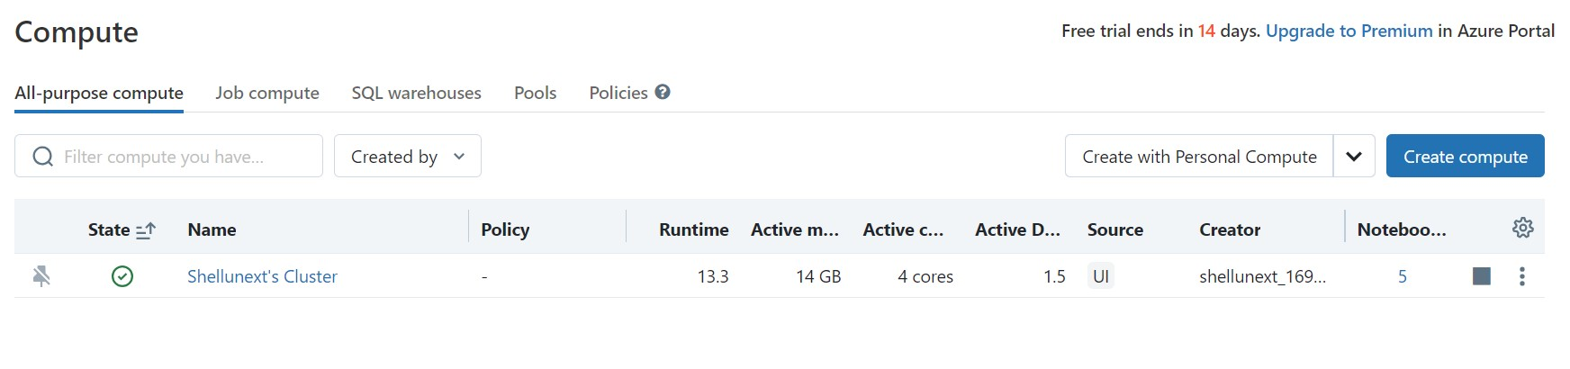

Slide 39
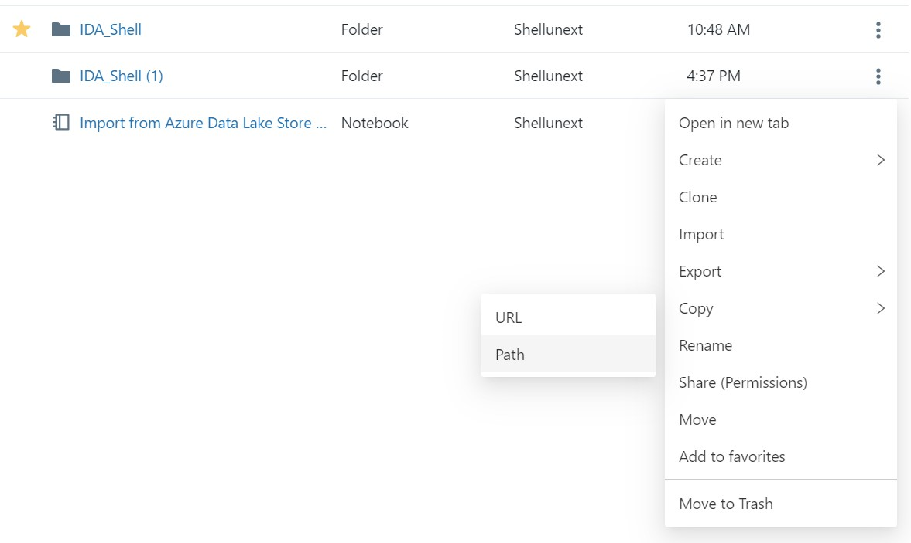

Slide 40
Day 20 – Azure Databricks continued…
Table creation through UI and through Notebook
Delta tables and their features
Parquet files and the delta log folder
Time travelling and CRUD operations
Vacuum and optimize functions
Table history and version control
Medallion/Multihop architecture
Bronze, silver and gold data layers
Restore … as version of … command
Workflow and jobs

Slide 41
Day 20 continued…
Job cluster creation and scheduling trigger
JDBC connection for Azure SQL
Unity catalog and its features
Creating metastore and sharing catalog
Access control and role assignment

Slide 42
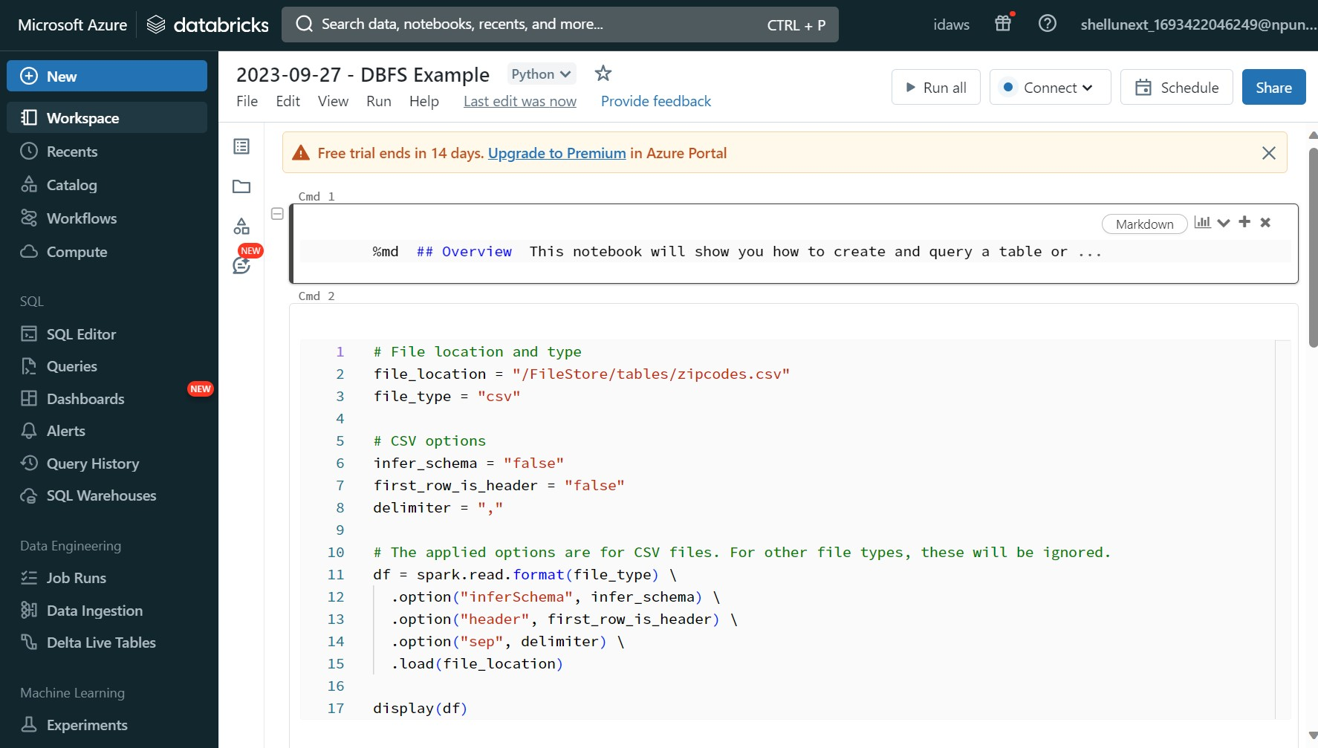

Slide 43
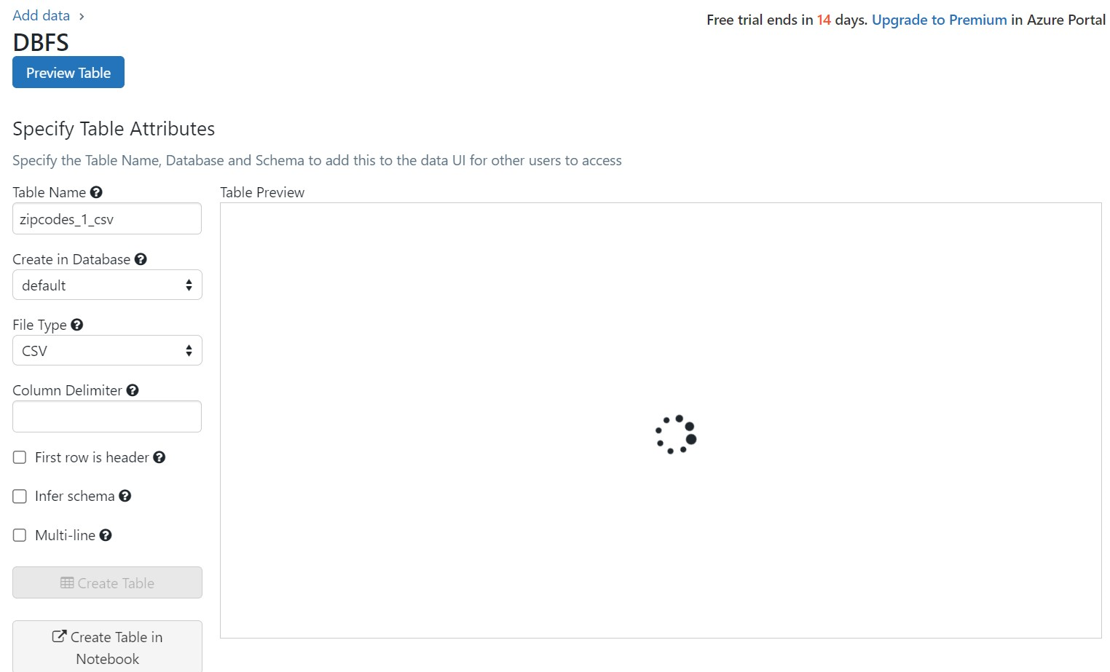

Slide 44
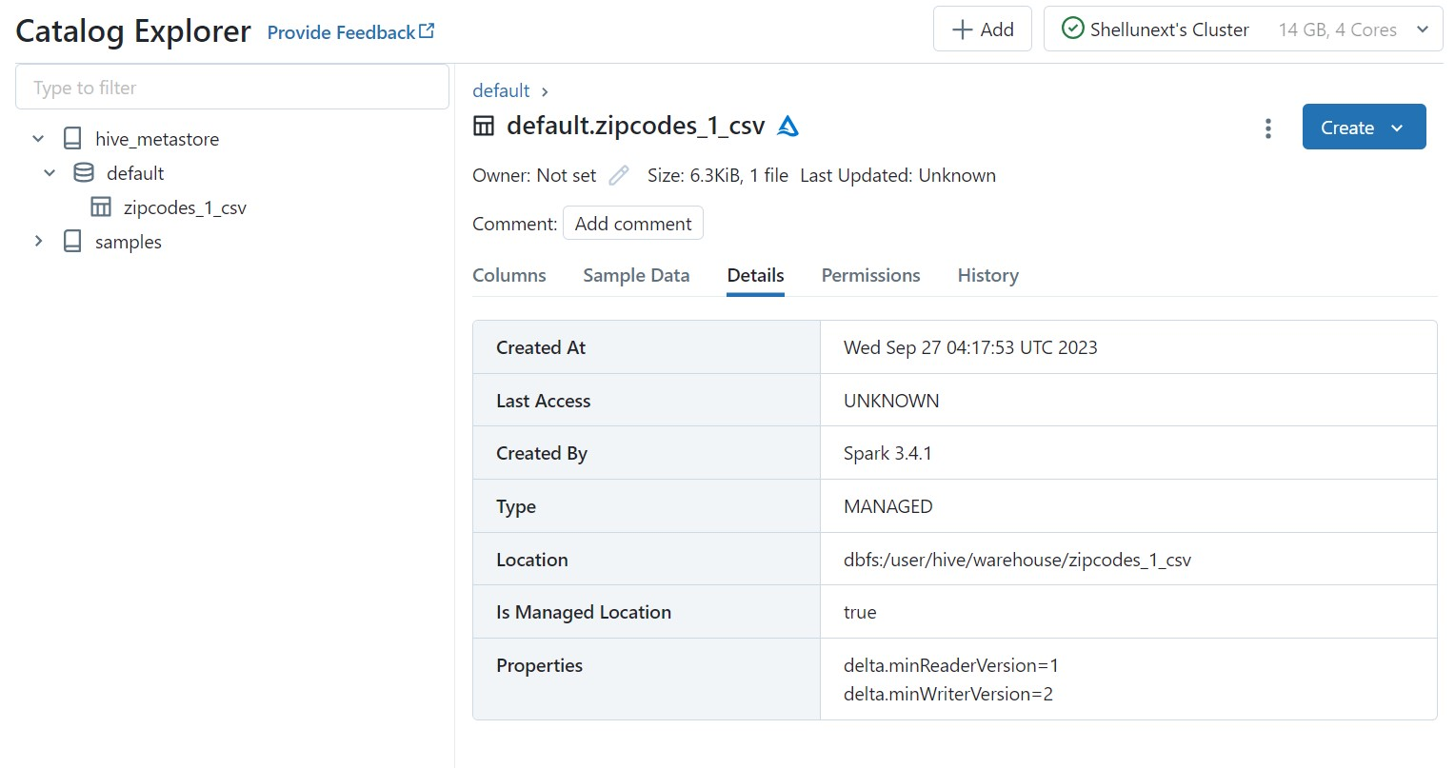

Slide 45
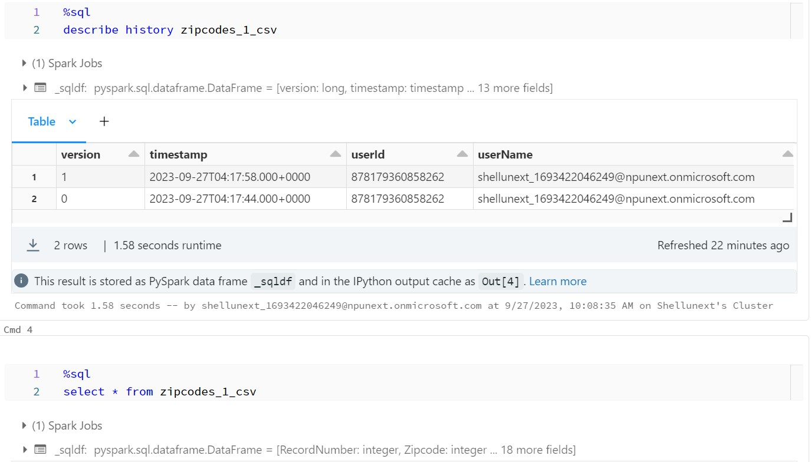

Slide 46
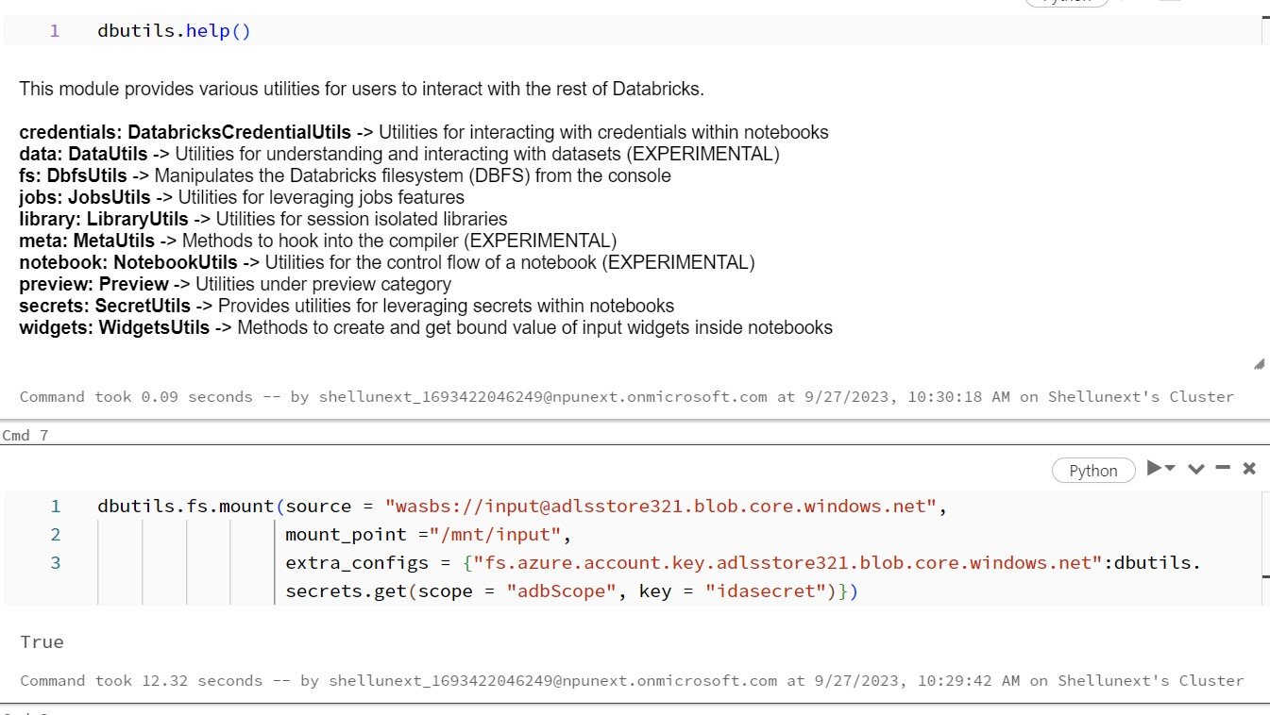

Slide 47
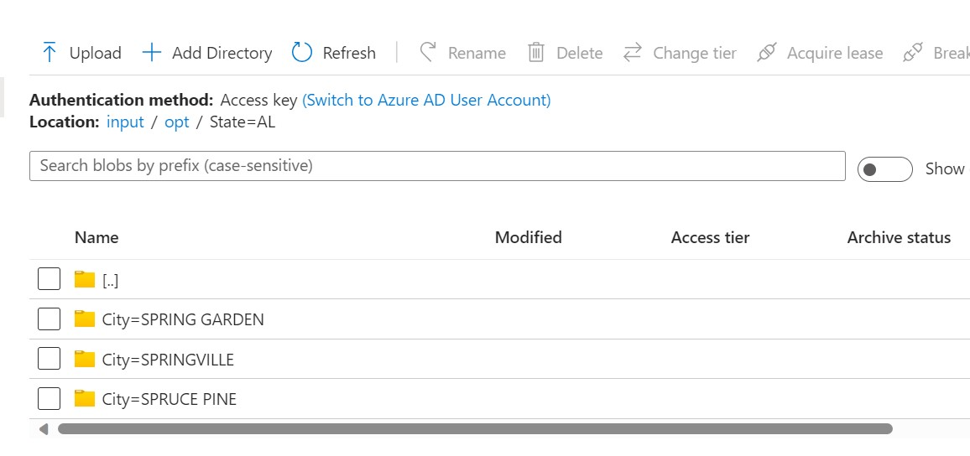

Slide 48
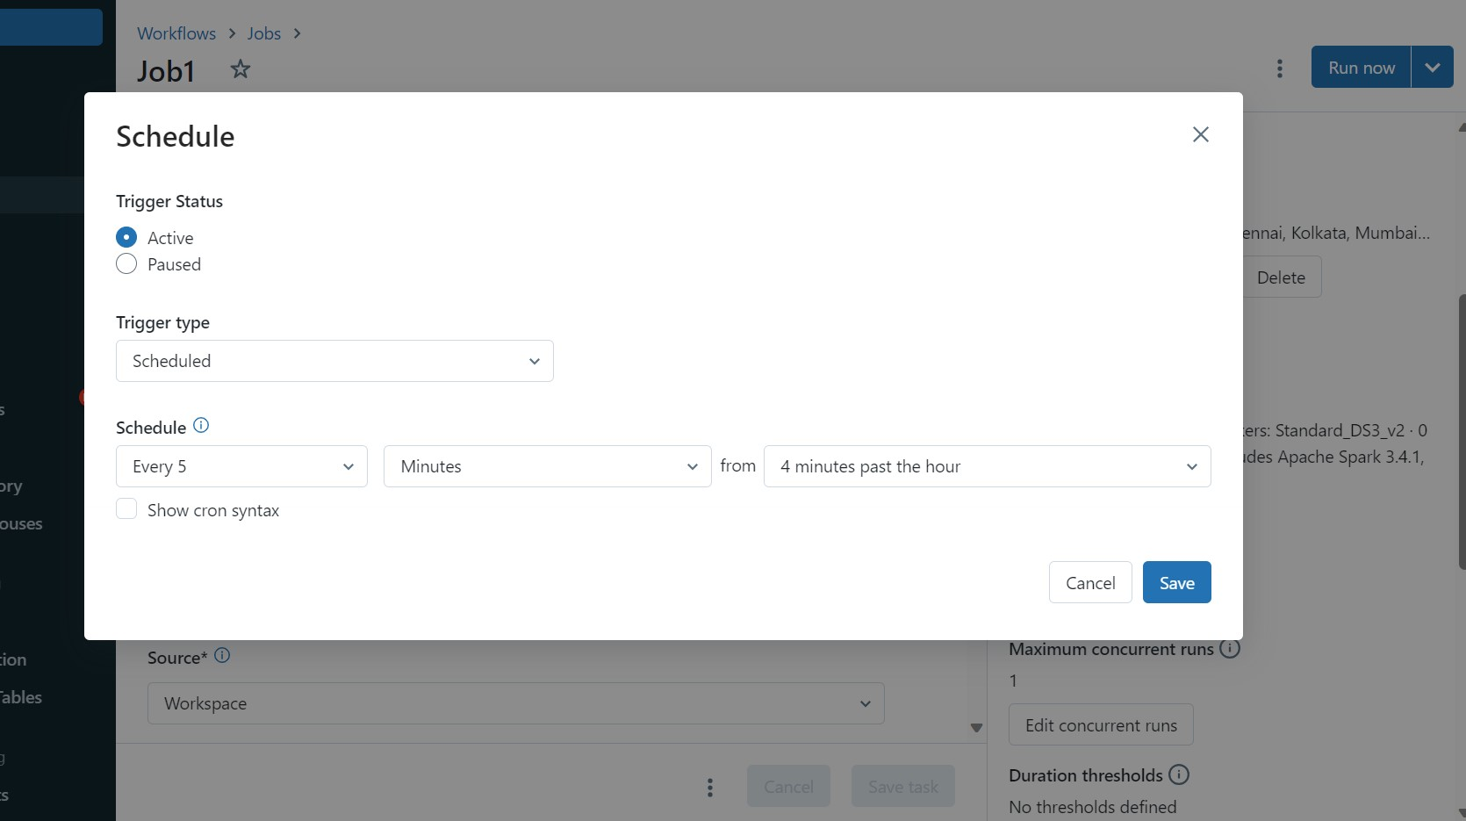

Slide 49
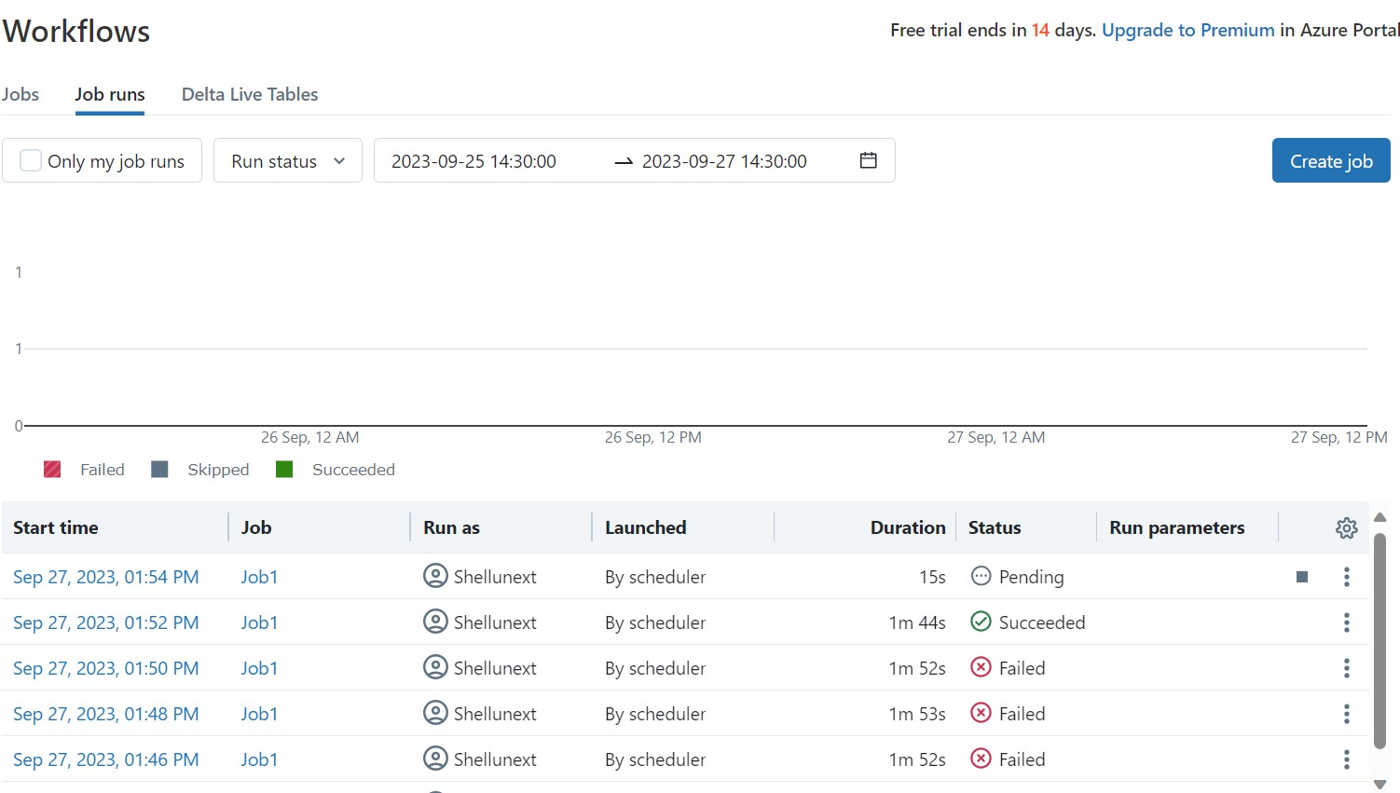

Slide 50
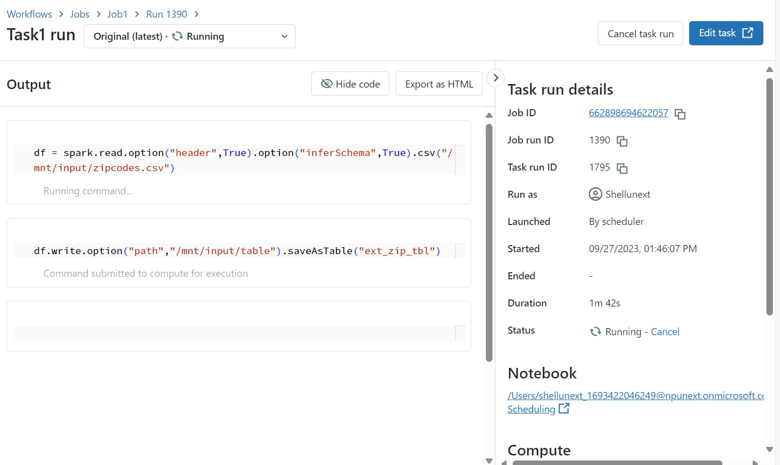

Slide 51
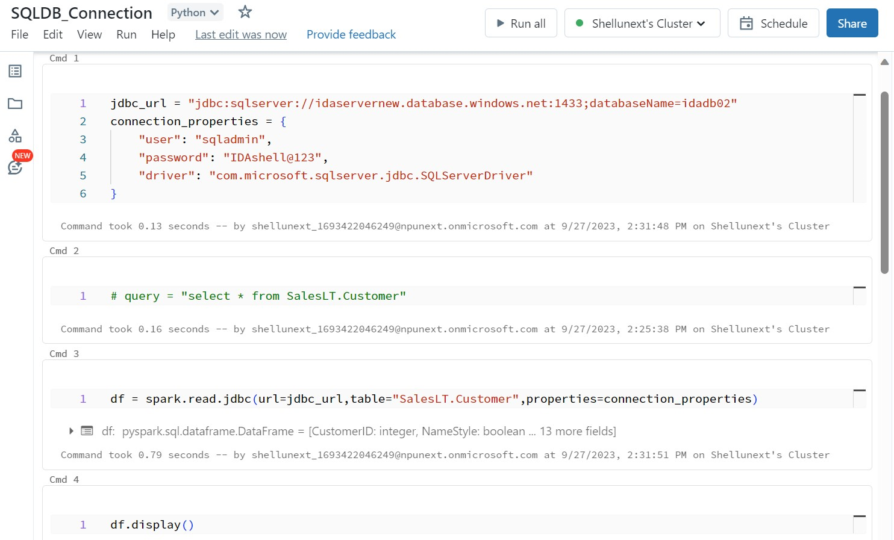

Slide 52
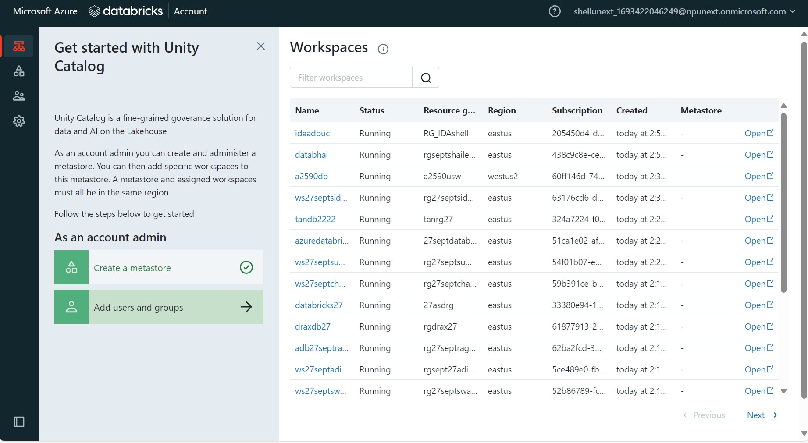

Slide 53
Day 21 – Docker and Kubernetes
Docker introduction
Start docker and create docker project
App.py, Dockerfile and requirements.txt files
Build docker image and run the app
Azure Container Registry (ACR) and Azure CLI
Azure login, Resource group creation from terminal
Creating ACR and ACR login
Tag docker image and push it to ACR
Kubernetes cluster configuration
Yaml files for deployment and service
Attach Azure Kubernetes Service (AKS) with ACR

Slide 54
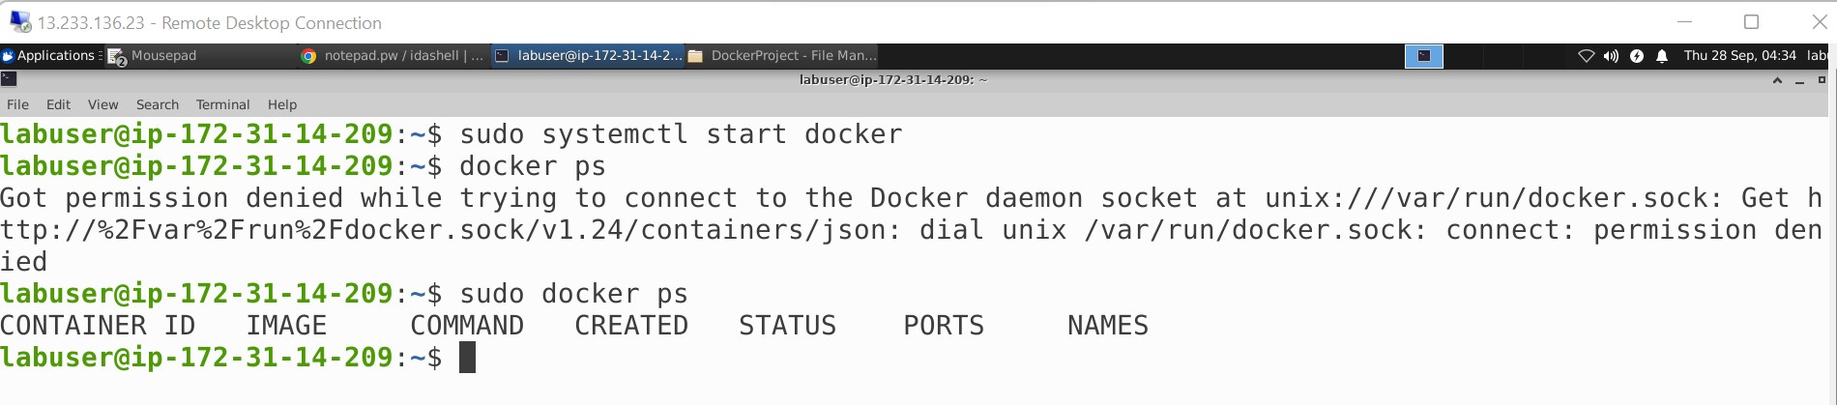

Slide 55


Slide 56


Slide 57


Slide 58


Slide 59


Slide 60


Slide 61


Slide 62


Slide 63


Slide 64


Slide 65


Slide 66


Slide 67
Day 22 – Azure DevOps
DevOps introduction and CI/CD
Collaboration (main) and feature branches
Azure DevOps project creation and setup
Azure Boards and Work items
Epic, Feature, User story and Task
Sprint and typical sprint duration
Creating Azure boards for a real time scenario
Billing configuration in Organization settings
Dashboards and Wiki
Waterfall and Agile models

Slide 68
Day 22 continued…
Work item creation and linking them with proper hierarchy
Repos overview and implementation
Creating and cloning repos
Pull requests to merge feature branch with the main branch
Version control through revert
Creating pipelines using a sample GitHub repository
Configure with starter or python package
Run the pipelines after generating a yaml file
Case study discussion

Slide 69


Slide 70


Slide 71


Slide 72


Slide 73


Slide 74


Slide 75


Slide 76


Slide 77


Slide 78


Slide 79


Slide 80


Slide 81


Slide 82


Slide 83


Slide 84


Slide 85


Slide 86


Slide 87


Slide 88


Slide 89


Slide 90


Slide 91


Slide 92


Slide 93


Slide 94


Slide 95


Slide 96


Slide 97


